Slide 1
Entrepreneurship CP-1
Group Members
Danial Ahmad
Muhammad Ahmed Mohsin
Muhammad Ali Farooq
Muhammad Umer
Syeda Fatima Zahra

Slide 2

Navigate your path to graduate admission

Slide 3

Problem
Students feel lost in the Grad School Maze!
The graduate school application process is complex and confusing
Unlike undergraduate admissions, graduate admissions are field-specific and put a far greater emphasis on research
Students struggle to
Identify research interests
Find relevant programs and professors
Connect with experienced mentors

Slide 4
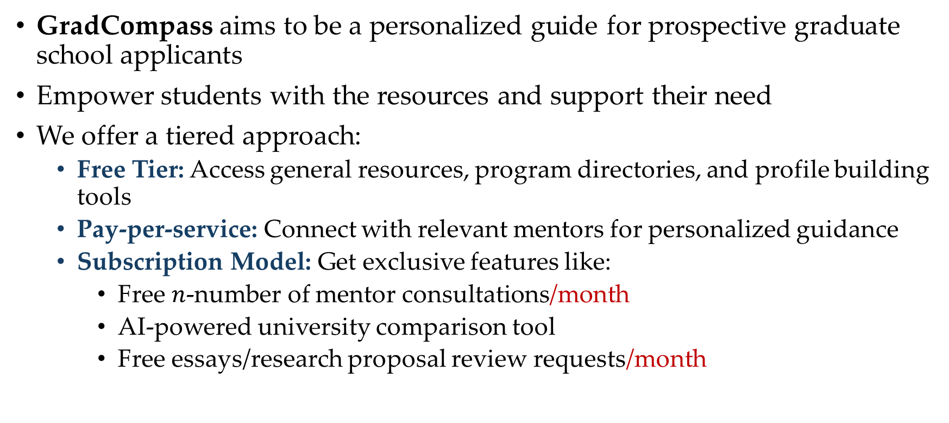
The Solution: GradCompass
GradCompass aims to be a personalized guide for prospective graduate school applicants
Empower students with the resources and support their need
We offer a tiered approach:
Free Tier: Access general resources, program directories, and profile building tools
Pay-per-service: Connect with relevant mentors for personalized guidance
Subscription Model: Get exclusive features like:
Free $n$-number of mentor consultations/month
AI-powered university comparison tool
Free essays/research proposal review requests/month

Slide 5
Unique Selling Proposition (USP)
Why Choose GradCompass?
GradCompass is a one-stop-shop for graduate school applicants. It combines a free tier with valuable resources, a pay-per-service option for mentorship, and a feature-rich subscription model with an AI-powered university comparison tool and essay review service.
Graduate Studies!
Our focus is on MS and PhD Emphasis on research
Affordable
Flexible options to fit your needs
Comprehensive
All the resources you need in one place
Innovation
AI power – “Retrieval-Augmented Generation (RAG)”

Slide 6
Porter’s Five Forces
Threat of New Entrants
The educational technology industry is relatively easy to enter, but it can be difficult to establish a strong brand and large network
Bargaining Power of Buyers
Students have few options to choose from when it comes to graduate school guidance platforms
Bargaining Power of Suppliers
There are a variety of suppliers of resources and services that can be used to create a graduate school guidance platform
Threat of Substitutes
There are a few substitute products and services available, such as graduate school guidebooks and online forums
Competitive Rivalry
The educational technology industry is a competitive landscape, with a number of established players but no one is specifically focusing on graduate admissions

Slide 7
RENT-X
Rent anything, to anyone

Slide 8
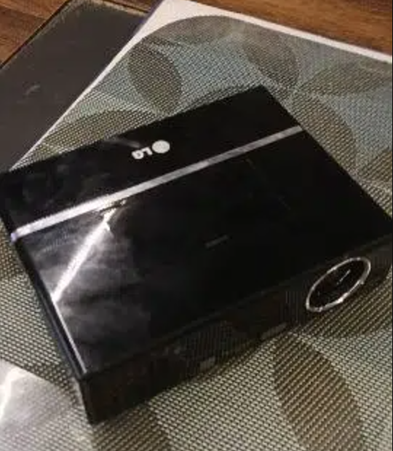
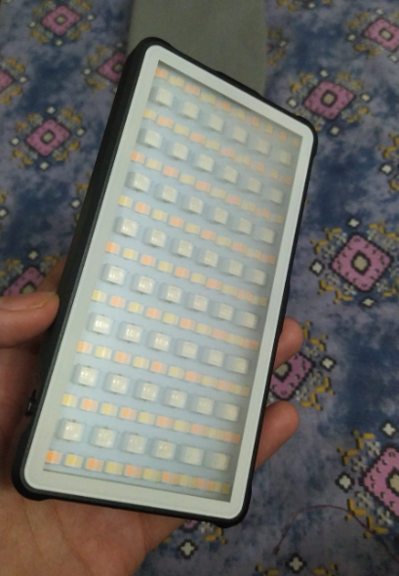
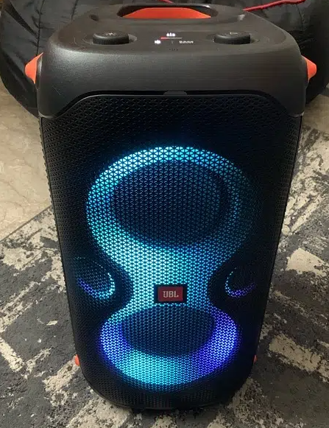
Useful items being Useless
We all have things in our homes that we spent a good chunk of money on, only for it to catch dust after one use.
17,000 pkr
7,500 pkr
40,000 pkr

Slide 9


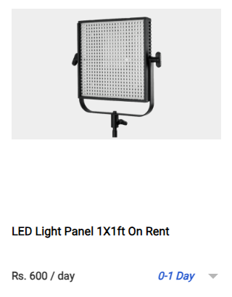
Rent Prices of Items
Now we have a look at how pricey it is to rent these items:
These ads are too professional and an ordinary person may not be encouraged to put in effort to make these ads.

Slide 10
~ English Proverb
“One man’s trash, is another man’s treasure.

Slide 11
RENT-X
Website
Safety
Allows users to upload their items on the website for renting.
Create security payment methods, that ensure safety of items and customers.
Our model is a C2C business Model.
No commissions, only ads and sponsored posts.

Slide 12
Unique Selling Proposition
Refundable Deposit
Delivery Options
Tutorial Videos
This security money is only returned to the buyer after the item has returned intact.
We provide an option to get your item delivered from door to door (extra charges apply).
The renter will upload tutorial videos on how to run the item, to avoid any confusion later on.

Slide 13
Porter’s Five Forces
Threat of New Entrants [Moderate]
Bargaining Power of Suppliers [Low]
Bargaining Power of Buyers [Moderate]
The C2C model itself is easy to enter as it requires minimal upfront investment
They have little power to negotiate since they are competing with each other for renters
There are other rental platforms and options like buying second-hand
Threat of Substitutes [Moderate]
Competitive Rivalry [Moderate to High]
Brick-and-mortar rental stores still exist, but may not offer the same variety or convenience
A larger user base attracts both renters and lenders, but it can be hard to compete with established platforms

Slide 14

There when you need it most

Slide 15
Problem
Everyday so many loved one’s pass away!
Organizing and managing complex funeral proceedings is difficult for the grieving
Managing the complexities of the funeral while managing emotions is very taxing
Existing contractors are scattered and hard to get a hold off

Slide 16

The Solution: Sahara
Sahara aims to be a professional and centralized system for supplying the grieving with the services necessary to see off their loved ones with ease and respect
Call or contact on 24-hour helpline, and we'll be at your doorstep in 2 hours

Slide 17
Unique Selling Proposition (USP)
Why Choose Sahara?
Professional and speedy service
Guaranteed quality for food and catering
As a centralised system, we can build trust and reputation
We are easy to approach, making it easy to penetrate the market
Competitors are scattered, small vendors, difficult to approach
Innovative
AI-powered

Slide 18
Porter’s Five Forces
Threat of New Entrants
The threat of new entrants is moderate due to the challenges in building trust and reputation, although our centralized approach and unique selling propositions can act as deterrents.
Bargaining Power of Buyers
Limited, due to their grieving nature and the value we offer in terms of convenience, reliability, and guaranteed quality.
Bargaining Power of Suppliers
There are a variety of suppliers of resources and services that can be used to create a graduate school guidance platform
Threat of Substitutes
The threat of substitutes is low due to the cultural significance and emotional nature of funerals, coupled with our streamlined service.
Competitive Rivalry Competitive rivalry is moderate, with our centralized approach and professionalism setting us apart from scattered, small vendors. However, vigilance and continuous innovation are necessary to maintain our competitive edge.

